Slide 1

Mini Project
File Backup Utility
Team Number: 22
Team Members:
Nived Shaji
Yeshwanth
Nithesh V
Course: B.E. CSE (VTU 2022 Scheme)
College: Gopalan College of Engineering and Management

Slide 2


Introduction
Simplicity
Portability
Easy to use with minimal user input – just enter source and destination paths.
Runs on any system with Python installed – no external dependencies.
Scalability
Security
Can handle large folders and be extended to support cloud backups or scheduling
Performs local backups without internet, reducing risk of data breaches.

Slide 3
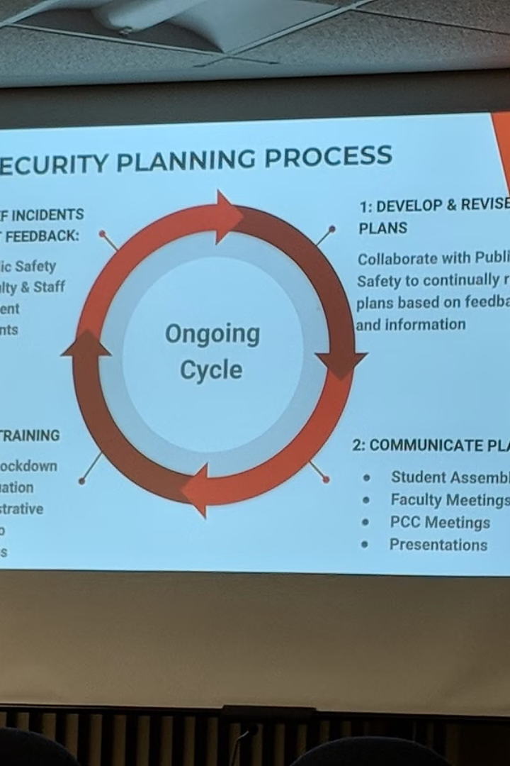
User Interface: A Visual Representation
Start Backup
Show Backup Path
Provides a simple prompt to enter the source and destination folders for backup.
Displays the exact location of the newly created backup folder with timestamp.
Repeat Backup
Exit Utility
Enables users to perform another backup without restarting the program.
Allows users to exit the backup tool after confirmation.

Slide 4
Challenges Faced
Handling file I/O efficiently
Input validation
optimizing file access and minimizing opening and closing operations, thereby enhancing the performance and reducing the unnecessary overhead
ensuring that the data entered into a system is accurate and complete. It involves checking user input against requirements, such as data type, format, and range, to prevent errors and malicious attacks like SQL injection.
Scalability
Designing error-free interface
ensuring that a system can handle increased workloads efficiently as the demand grows., involving designing flexibility that helps to accommodate more users, data, or processes without performance degradation.
creating a user-friendly and intuitive design that minimizes the chances of user errors. including clear navigation, consistent layouts, and meaningful feedback for user actions.

Slide 5
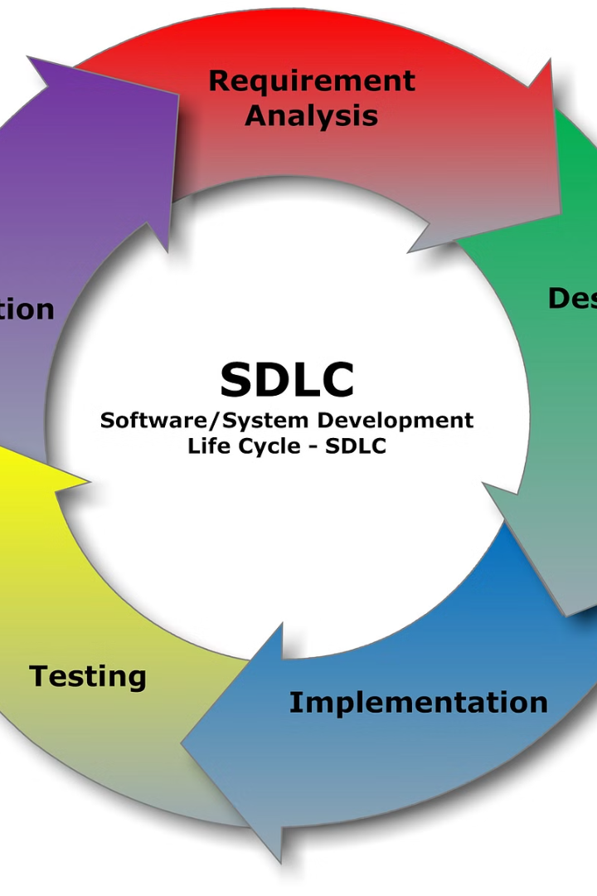
Future Enhancements: Optimizing the System
1
Cloud Integration
Transitioning to a cloud storage system for improved scalability and data management.
2
Web and Mobile Versions
Developing web and mobile applications to enhance user accessibility and convenience.
3
Data Security Measures
Implementing data encryption and authentication protocols to safeguard sensitive information.

Slide 6
Conclusion: A Promising Foundation
Proven Capabilities
Future Direction
Ensuring efficient handling of data, seamless operations, and reliable performance. These features build trust and simplify the backup tasks effectively.
Future enhancements, such as cloud integration and advanced security, will further enhance the system's capabilities by bounds. Increasing the number of users using the software

Slide 7
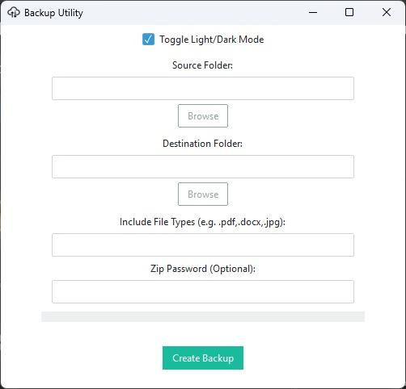
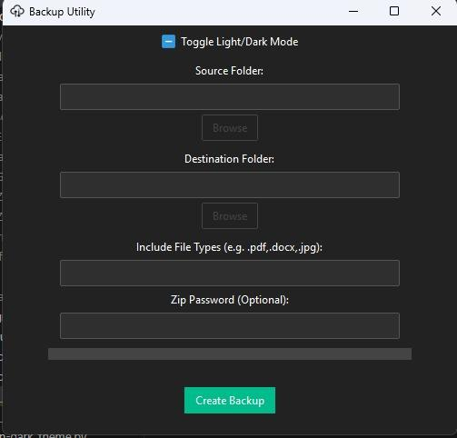
GUI

Slide 8

Acknowledgments
We sincerely thank our guide, Archana Ma’am, for her invaluable support, guidance, and encouragement throughout our mini-project. We also extend our heartfelt gratitude to Dr.Manoj Challa for his insights and assistance, which greatly enriched our work. Lastly, we thank everyone who contributed to the successful completion of this project.

